Slide 1
Materials and Products for Powder Metallurgy
Powder metallurgy technology is applied above all in the following fields:
1. A manufacture of powder metals, alloys and compounds as a material for a direct use – utilization in various technological fields (protective and decorative coatings, pyrotechnics, welding and surfacing, catalyzers in chemical industry, cementing materials for hydrometallurgy etc.).
2. A manufacture of materials and products with special properties which cannot be achieved by classical metallurgy and metal processing – cemented carbides, dispersion hardened materials, porous metal materials, friction and sliding materials, contact materials of W-Cu, W-Ag type, composition of metal with nonmetal, such as Cu-C, Fe-C, Ag-CdO, superhard materials, etc.
3. A manufacture and processing of materials and products of common materials with typical or high technical parameters, but with advantageous technical-economic indicators – lower production cost, lower consumption of metals and energy, suitable conditions for process automatization, wage cost saving, etc.

Slide 2
The raw materials for PM processing are more expensive than for other metalworking because of the additional energy required to reduce the metal to powder form. Accordingly,
PM is competitive only in a certain range of applications. In this section we identify the materials and products that seem most suited to powder metallurgy.
Powder Metallurgy Materials
From a chemistry standpoint, metal powders can be classified as either elemental or pre-alloyed. Elemental powders consist of a pure metal and are used in applications in which high purity is important. For example, pure iron might be used where its magnetic properties are important. The most common elemental powders are those of iron, aluminum, and copper.

Slide 3
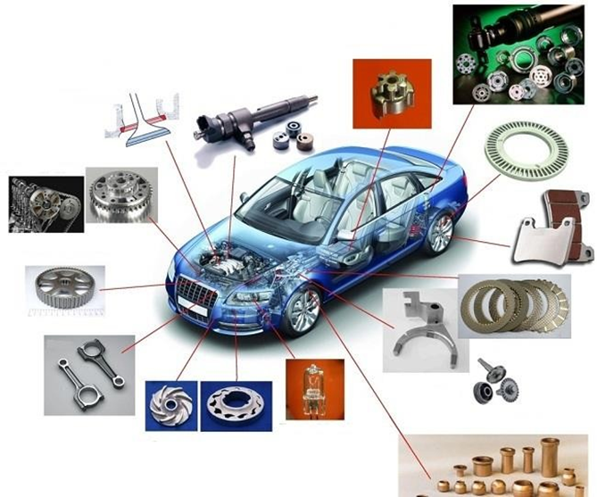
Figure (1) Application of powder metallurgy products in various parts of a passenger vehicle

Slide 4
Elemental powders are also mixed with other metal powders to produce special alloys that are difficult to formulate using conventional processing methods.
Tool steels are an example; PM permits blending of ingredients that is difficult or impossible by traditional alloying techniques.

Slide 5
Using mixtures of elemental powders to form an alloy provides a processing benefit, even where special alloys are not involved.
Because the powders are pure metals, they are not as strong as pre-alloyed metals. Therefore, they deform more readily during pressing, so that density and green strength are higher than with pre-alloyed compacts.

Slide 6
In pre-alloyed powders, each particle is an alloy composed of the desired chemical composition.
Pre-alloyed powders are used for alloys that cannot be formulated by mixing elemental powders; stainless steel is an important example.
The most common pre-alloyed powders are certain copper alloys, stainless steel, and high-speed steel.

Slide 7
The commonly used elemental and pre-alloyed powdered metals, in approximate order of tonnage usage, are:
(1) iron, by far the most widely used PM metal, frequently mixed with graphite to make steel parts,
(2) aluminum,
(3) copper and its alloys,
(4) nickel,
(5) stainless steel,
(6) high-speed steel, and
(7) other PM materials such as tungsten, molybdenum, titanium, tin, and precious metals.

Slide 8
A substantial advantage offered by PM technology is that parts can be made to near net shape or net shape; they require little or no additional shaping after PM processing.
Some of the components commonly manufactured by powder metallurgy are gears, bearings, sprockets, fasteners, electrical contacts, cutting tools, and various machinery parts.

Slide 9
When produced in large quantities, metal gears and bearings are particularly well suited to PM for two reasons:
(1) the geometry is defined principally in two dimensions, so the part has a top surface of a certain shape, but there are no features along the sides; and
(2) there is a need for porosity in the material to serve as a reservoir for lubricant.
More complex parts with true three-dimensional geometries are also feasible in powder metallurgy, by adding secondary operations such as machining to complete the shape of the pressed and sintered part, and by observing certain design guidelines such as those outlined in the following section.

Slide 10
    Fe-based PM product (PM products based on iron with low or medium strength)
PM product strength values can be improved through two basic methods:
      Decrease in porosity.
      Alloying with appropriate additives.
Powder compressibility has a critical influence on a decrease in porosity of a sintered product. Fig. 2 shows that even unalloyed Fe powders differ considerably in density achievable after pressing. When using all technological possibilities for compaction (pressing, sintering, forging after sintering, HIP) and having 5 % residual porosity, iron unalloyed powders enable to obtain a value of tensile strength around 300 MPa and ductility up to 25 %.

Slide 11
A comparison of strength characteristics of the sintered iron and carbon steel, which are strongly dependent on density, powder properties and sintering conditions, is shown in Fig. 3. Main applications of the unalloyed iron powder are in a manufacture of machine parts for low loads and a manufacture of soft magnets working in direct current electrical fields.
Iron-based alloys can be prepared by various methods:
Mixing of powders of elementary metals or pre-alloys.
Diffusion alloying of powders.
Using pre-alloys prepared e.g. by melt atomization.
Mixing of powders of elementary metals and pre-alloys, the so-called hybride alloys.

Slide 12
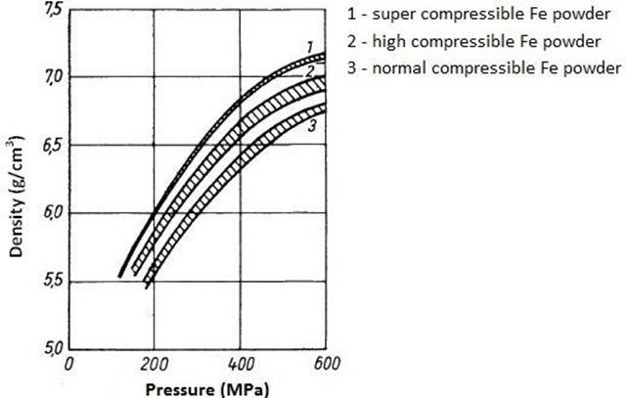
Figure (2) Comparison of compressibility of various types of Fe-powders.

Slide 13
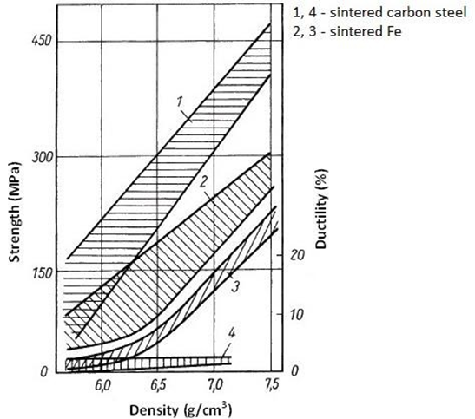
Figure (3) Comparison of strength characteristics of the sintered iron and carbon steel.

